Slide 1

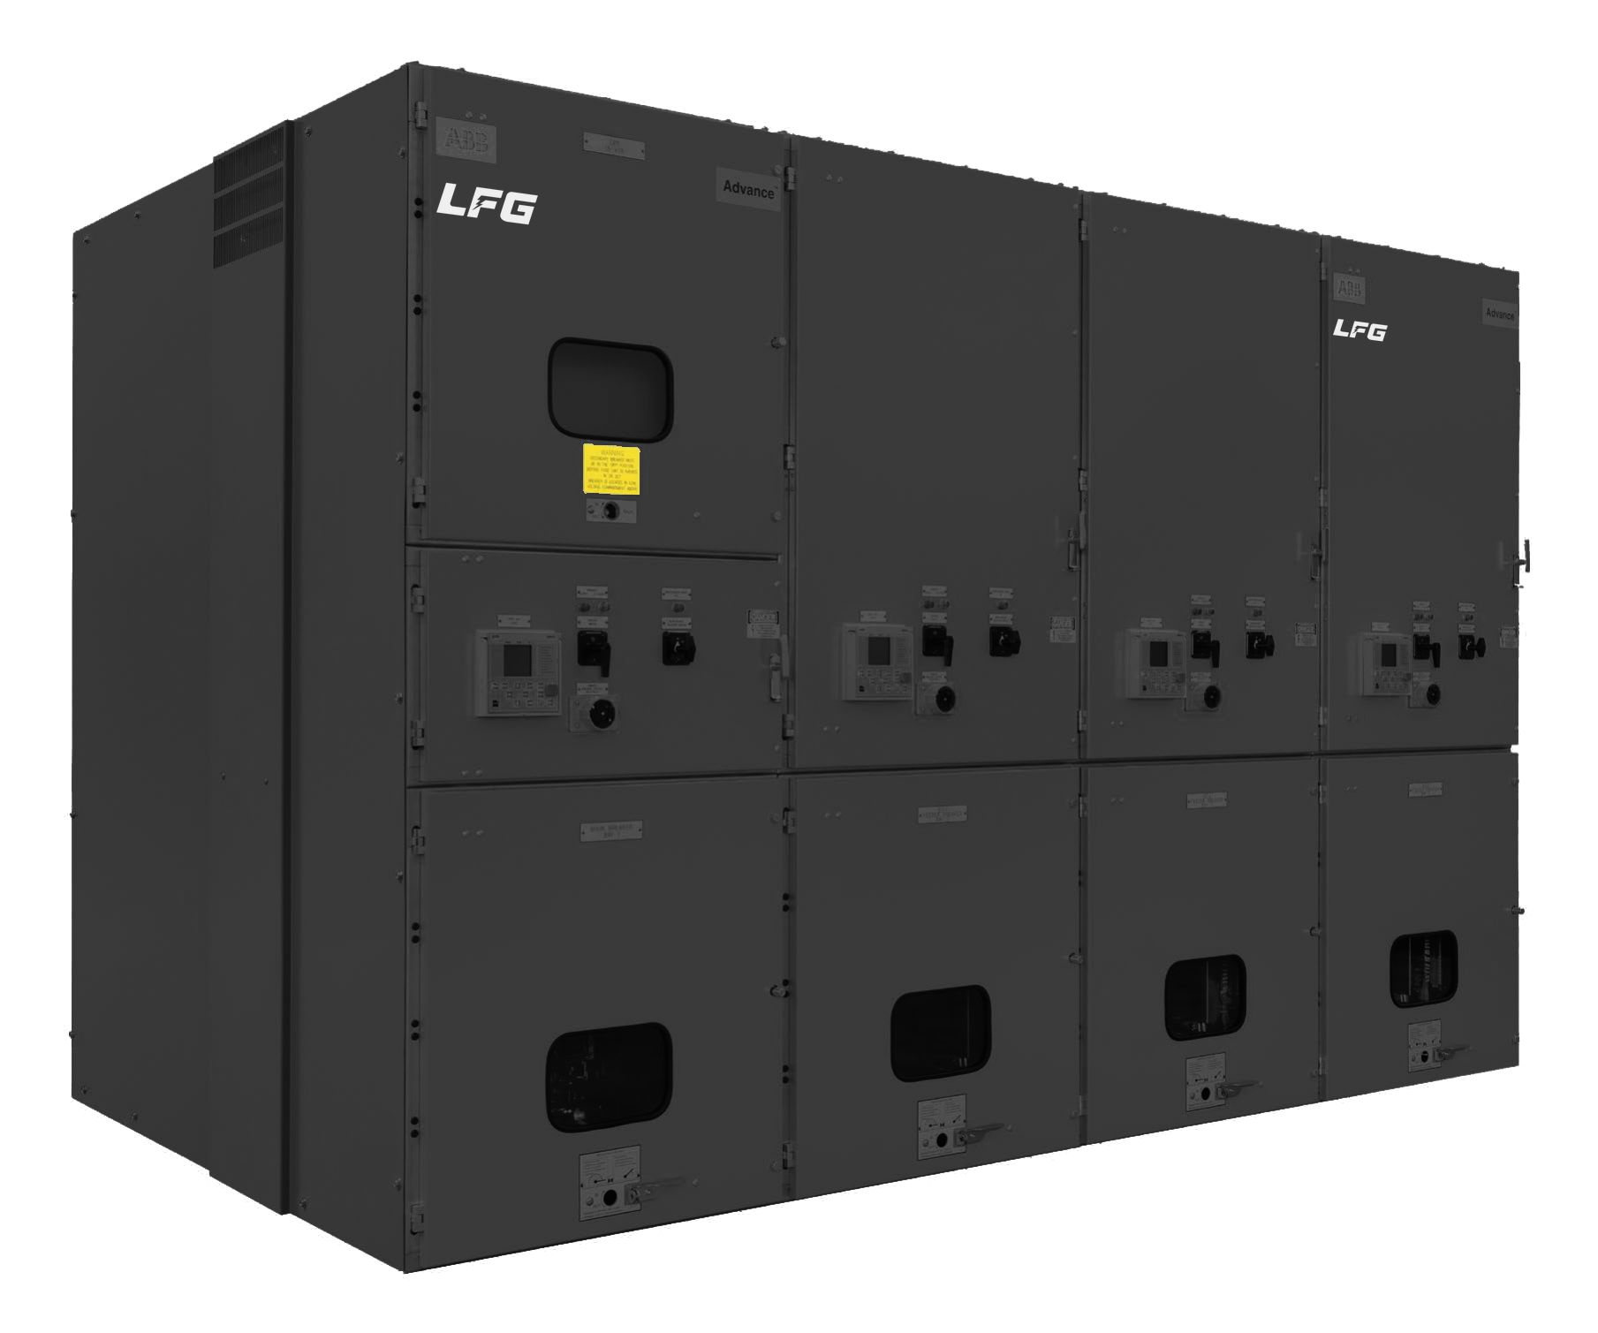
CERTIFIED ABB OEM PARTNER
Medium Voltage
Switchgear Solutions
ABB type-tested technology, delivered with the speed, engineering, and flexibility that keep your projects on schedule.
Powering the medium-voltage market through 2031 and beyond
Medium Voltage Switchgear Solutions · Certified ABB OEM Partner
In partnership with ABB

Slide 2





THE MARKET OPPORTUNITY
Demand is surging — and lead times are the bottleneck
Data centers, oil & gas, and industrial expansion are driving record demand for MV switchgear. As major manufacturers stretch to keep up, extended lead times have opened a clear opening for a fast, certified partner.
$13.6B
90 GW
$9.7B
U.S. / global data-center switchgear market by 2031, up from $4.8B in 2024 — a 16.1% CAGR.
Projected U.S. data-center capacity by 2030 — roughly triple today's, much of it MV-fed.
North America MV switchgear market by 2031, with hyperscale AI facilities reshaping demand.
The gap LFG fills: when a top-tier manufacturer quotes long lead times, a certified ABB OEM partner delivers the same type-tested technology — faster.
Medium Voltage Switchgear Solutions · Certified ABB OEM Partner
In partnership with ABB

Slide 3




WHY LFG + ABB
A certified partnership that de-risks your MV project
As a certified ABB OEM partner, LFG builds on ABB's proven, type-tested metal-clad switchgear platform and completes it with our own engineering, protection, and integration — so you get global-grade technology backed by local speed and accountability.
ABB type-tested platform
UL / UR certified pathway
Built on ABB's proven metal-clad primary power system — the same technology trusted on the most demanding projects.
A simplified certification route with no additional type testing when UR requirements are followed.
LFG engineering value-add
Speed & supply-chain control
Protection, control wiring, automation, and final testing completed by LFG for your exact application.
Shorter lead times, the ability to stock frames ahead of demand, and a single point of accountability.
Medium Voltage Switchgear Solutions · Certified ABB OEM Partner
In partnership with ABB

Slide 4



THE SOLUTION
LFG MV switchgear, built on ABB's FastFlex™ platform
ABB's FastFlex™ offering combines a type-tested primary power system with modular engineering. LFG uses it to design, configure, and deliver customized protection, automation, and control architectures — with the flexibility to meet your schedule.
Fully tested & UL/UR certified
Faster delivery
Industry certifications for seamless project approval and quality assurance.
Simplified ordering minimizes factory design and assembly time.
Pre-engineered sections
Customizable control wiring
Factory-assembled and ready to integrate, reducing engineering time.
LFG adds tailored control wiring to fit each project's needs.
Medium Voltage Switchgear Solutions · Certified ABB OEM Partner
In partnership with ABB

Slide 5





KEY BENEFITS
Expand your MV offering — with less cost, risk, and time
An installation-ready model that lets LFG customers enter or grow in medium voltage with reduced development costs, minimized certification risk, and improved control over project schedules.
Faster time to market
40%
footprint reduction with digital sensors
Reduced engineering complexity
Simplified UL certification pathway
80%
reduction in control wiring
Modular and scalable design
OEM flexibility with ABB technology
0
additional type testing when UR requirements are followed
Digital-ready architecture
Figures shown are “up to” values per ABB FastFlex™ platform specifications.
Medium Voltage Switchgear Solutions · Certified ABB OEM Partner
In partnership with ABB

Slide 6


OFFERING STRUCTURE
Two ways to buy — matched to your speed and flexibility needs
The FastFlex™ portfolio offers two models. LFG helps you select — and delivers — the right one for each project.
MAXIMUM FLEXIBILITY
FASTEST DELIVERY
FastFlex™ Abbreviated
FastFlex™ SKU
A complete line-up switchgear platform
Factory-assembled structure with bus, breakers, and compartments
LFG completes protection, control wiring, and UL listing
Reduces development cost and certification risk
Broad configuration flexibility for many applications
Pre-engineered single-frame sections for faster delivery
Standardized, ready-to-integrate frames
Factory-installed primary power components
Designed for the shortest lead times and quick deployment
Ideal for stocking and fast-track projects
Medium Voltage Switchgear Solutions · Certified ABB OEM Partner
In partnership with ABB

Slide 7

OFFERING DETAILS
FastFlex™ Abbreviated
Engineered to Order
A modular platform where ABB supplies the structural frame, breaker compartments, primary bus system, and core power components as a UL-Recognized assembly for Advance® and Advance® 27. LFG completes the system with protection relays, control wiring, automation, and final testing.
ABB delivers
LFG completes
Factory-assembled metal-clad switchgear frames
Main horizontal and vertical busbars
Circuit breaker compartments
Instrument compartments
Ground bus system
Mechanical interlocks and safety shutters
Low-voltage control (LVC) wiring & door fabrication
Protection relays and surge arrestors
Instrument transformer assembly (optional)
CPT and fuses (optional)
UL listing of the finished product
Factory (FAT) and site (SAT) acceptance testing
Medium Voltage Switchgear Solutions · Certified ABB OEM Partner
In partnership with ABB

Slide 8
OFFERING DETAILS
FastFlex™ SKU
Configure to Order
Pre-engineered switchgear sections with standardized dimensions and commonly requested ratings. These configurations cut factory engineering time for significantly shorter lead times — while maintaining the same reliability and safety standards as the Abbreviated platform.
ABB delivers
LFG completes
Pre-engineered single-section frames
Main horizontal and vertical busbars
Factory-installed primary power wiring
Breakers with current & voltage sensors
CT / PT provisions
Standardized footprints & digital-sensor compatibility
Stacking single frames into a complete line-up
LVC wiring & door fabrication
Assemble relays and surge arrestors
Assemble instrument transformers, CPT, and fuses
Ability to stock frames in advance of demand
Factory (FAT) and site (SAT) acceptance testing
Medium Voltage Switchgear Solutions · Certified ABB OEM Partner
In partnership with ABB

Slide 9
SIDE BY SIDE
FastFlex™ Abbreviated vs. SKU — at a glance
 | FastFlex™ Abbreviated | FastFlex™ SKU
Design type | Engineered to Order | Configure to Order (CTO)
Ships as | Switchgear line-up | Single sections
Lead time | 35 weeks | 20–25 weeks*
PFA (if needed) | Required | Not required
Control wiring | By LFG | By LFG
Configurations | Engineered per project | ~70 standard
Ratings | 5, 15, 27 kV · up to 4000 A | 5, 15 kV · up to 3000 A
Enclosure options | Indoor / Outdoor | Indoor
Interrupting rating | Up to 63 kA | Up to 50 kA
* SKU lead time reflects factory-installed current & voltage sensors, or CT/PT provisions and mounting hardware. Only ABB-approved CTs and PTs are accepted to maintain UL/UR certification.
Medium Voltage Switchgear Solutions · Certified ABB OEM Partner
In partnership with ABB

Slide 10



THE LFG ADVANTAGE
More than a supplier — your MV integration partner
LFG turns ABB's type-tested platform into a finished, project-ready system — adding the engineering, integration, and testing that lower your barrier to entry into the medium-voltage market.
Protection & controls engineering
UL listing & certification
Factory & site testing
Relays, surge arrestors, and LVC wiring designed and assembled to your specification.
We complete UL listing on the finished product, following UR requirements to avoid re-testing.
Full FAT and SAT so equipment arrives proven, commissioned, and ready to energize.
Value-add assembly
Supply-chain control
Single point of accountability
Instrument transformers, CPT, and fuses assembled and integrated as your project requires.
Stock single-section frames ahead of demand for the shortest, most predictable lead times.
One partner from configuration through commissioning — local support, clear ownership.
Medium Voltage Switchgear Solutions · Certified ABB OEM Partner
In partnership with ABB

Slide 11




WHERE IT FITS
Built for the markets driving MV demand through 2031
LFG's ABB-partnered switchgear serves the applications where speed, reliability, and certification matter most.
Data Centers
Oil, Gas & Energy
Industrial & Manufacturing
Utilities & Renewables
Fast-track MV distribution for hyperscale and colocation build-outs where schedule is everything.
Robust, certified switchgear for demanding upstream, midstream, and processing environments.
Reliable power distribution for plants, expansions, and capacity-driven projects.
Indoor and outdoor line-ups for grid, substation, and solar-plus-storage interconnection.
Medium Voltage Switchgear Solutions · Certified ABB OEM Partner
In partnership with ABB

Slide 12



Bring MV to market —
faster, and certified.
Partner with LFG — a certified ABB OEM partner — to deliver type-tested medium-voltage switchgear with the speed, engineering, and accountability your projects demand.
CONTACT
EMAIL
PHONE / WEB
Dalia Leyous · Sr. Sales Engineer
dleyous@lfg.us
(954) 643-5135 · lfg.us
In partnership with ABB. FastFlex™, Advance® and Advance® 27 are trademarks of ABB.
Medium Voltage Switchgear Solutions · Certified ABB OEM Partner
In partnership with ABB

