Slide 1
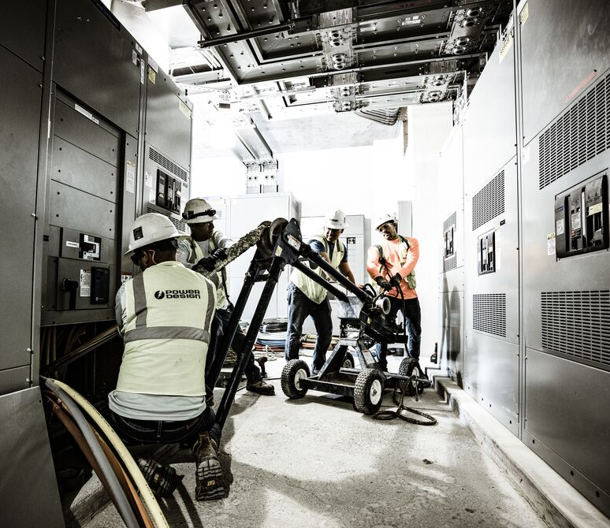

Specialty Manufacturing
Power Design Switchboards
Delivering Power and Reliability

Slide 2
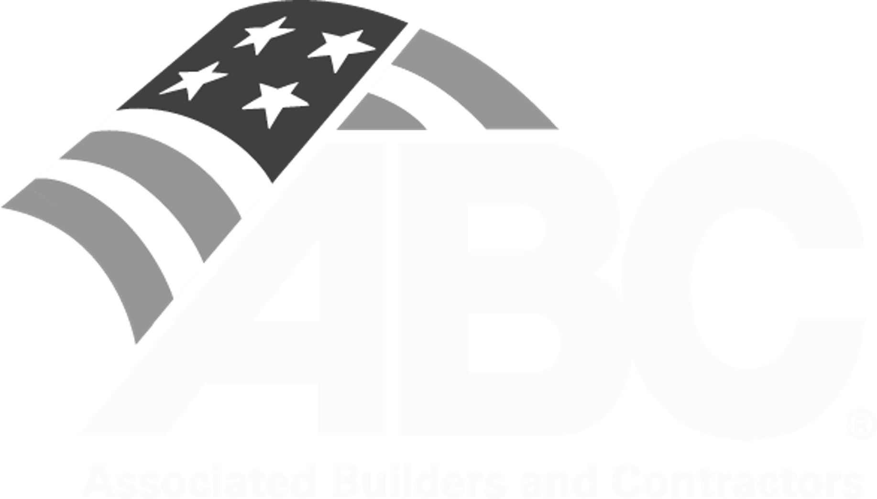


Specialty Manufacturing
WE
GET
POWER
With 35 years in electrical contracting, Power Design understands the complex electrical
distribution demands of large-scale projects. We’ve developed extensive best practices and
training protocols which have led to a culture of excellence, safety, and quality; something the industry has recognized us for, across many years.
Recently, we’ve seen demand outpace supply in the switchgear market. While lead times
are improving, it’s a perpetual challenge. To take control of uncertainty and ensure our
partners’ success, we’ve developed our Specialized Manufacturing Division focused on manufacturing switchboards and other critical power equipment. Leveraging our years of
expertise in electrical design-build, and in partnership with LS Electric, ABB, and Square D,
we’re delivering critical power, reliably.
0.52 EMR Safety Record –vs- 1.0 Industry Average
1,856 Completed Electrical Projects | 340 Active Projects
280 Person Design Division | 18 Licensed Pro. Engineers
Top Electrical Contractors | Accredited Quality Contractor
Top 20 Electrical Design Firm
Top 40 Electrical Design Firm

Slide 3


















Specialty Manufacturing
TRUSTED PARTNERSHIPS
Power Design switchboards are trusted by the teams who power progress—developers, engineers, and energy leaders nationwide. Backed by decades of innovation and field-tested performance, our gear delivers reliability when it matters most.
TRUSTED BY LEADING DEVELOPMENT PARTNERS
ON PROJECTS DESIGNED BY LEADING FIRMS

Slide 4


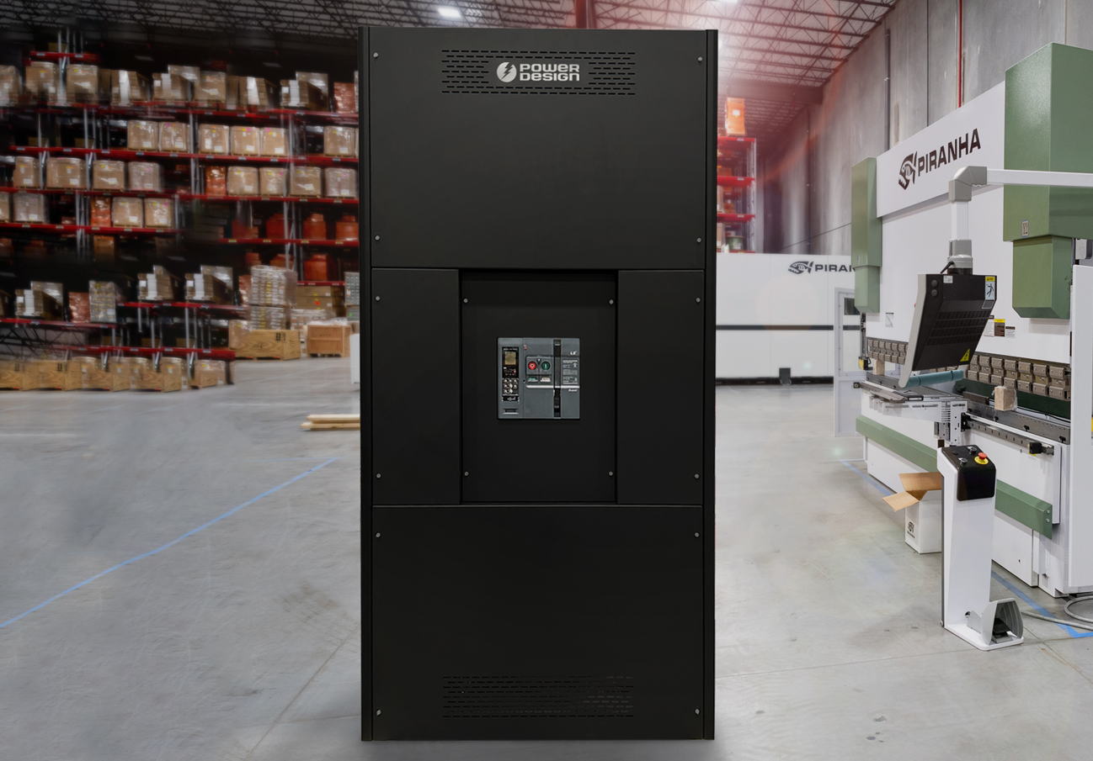
Specialty Manufacturing
PD-UL 891 SWITCHBOARD
Switchboard Features
FEATURES & BENEFITS
Up to 4000 ampere main bus rating
Up to 600 volts AC
Bus bracing up to 100KAIC
Silver- or tin-plated copper bus
UL Air circuit breakers from 1200A to 4000A
UL 489 Molded case circuit breaker feeders from 100 to 2500A
Main and branch circuit breakers and fusible switches
Thermal magnetic and solid state circuit breakers
Standards & Certifications: UL891; NEMA PB-2; NEC
Surge protective devices
Ground fault protection on mains and distribution devices
Busway and transformer connections
NEMA 1 enclosures
TYPICAL DELIVERY WITHIN 20 WEEKS
UL CERTIFIED PRODUCT & STAFF
EXTENSIVE QUALITY
& SAFETY CONTROLS
CONSTRUCTION-MINDED DESIGN

Slide 5
Specialty Manufacturing
BUILT TO LAST,
Supported By Expert Service
Our switchboards come standard with an 18-month warranty and extended terms available. Components within each switchboard follow their respected manufacturers warranties, per industry standards. With over two years of component inventory and expert technicians available within 72 hours, we deliver the support and reliability you can count on.
126+ switchboards built or in progress
269 sections currently in backlog
60,000 sq. ft. production facility dedicated towards manufacturing, state-of-the-art assembly, and quality testing
9 custom switchboard designers
8 specialized machine operators
274 combined years of experience
126 switchboards completed
269 sections in backlog

Slide 6
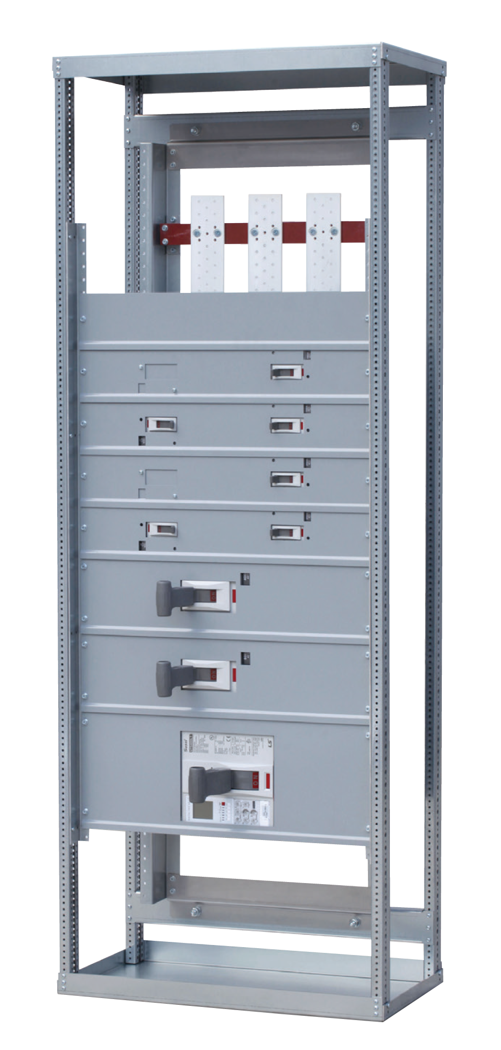
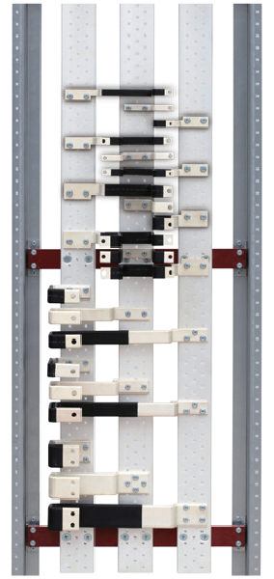
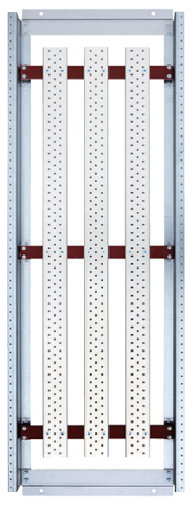
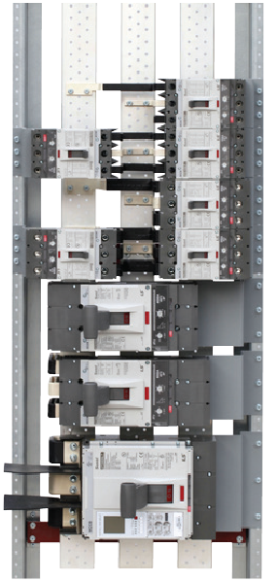

Specialty Manufacturing
PD-UL 891 SWITCHBOARD
Switchboard Structure
1
Bust Strap
Single mounting type
Double mounting type
Installation case
2
Interior
1200A (single chassis bus)
2000A (double chassis bus)
2400/4000/6000A
3
UL489 MCCB
Ampere rating: 40~1200A
Poles : 2, 3
Various trip units:
FTU, FMU, ATU, ETS,
ETM, OCR, MCP, MCS
Standards: UL489,
IEC60947-2
150AF of single bus strap
150AF of double bus strap
800AF of single bus strap
A
B
C
1
2
3
A
B
C
POWERED BY

Slide 7
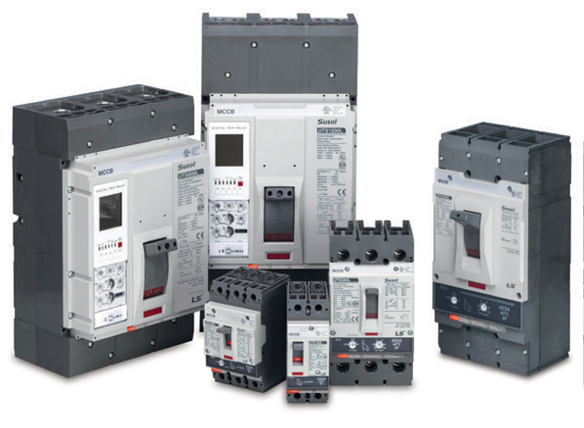
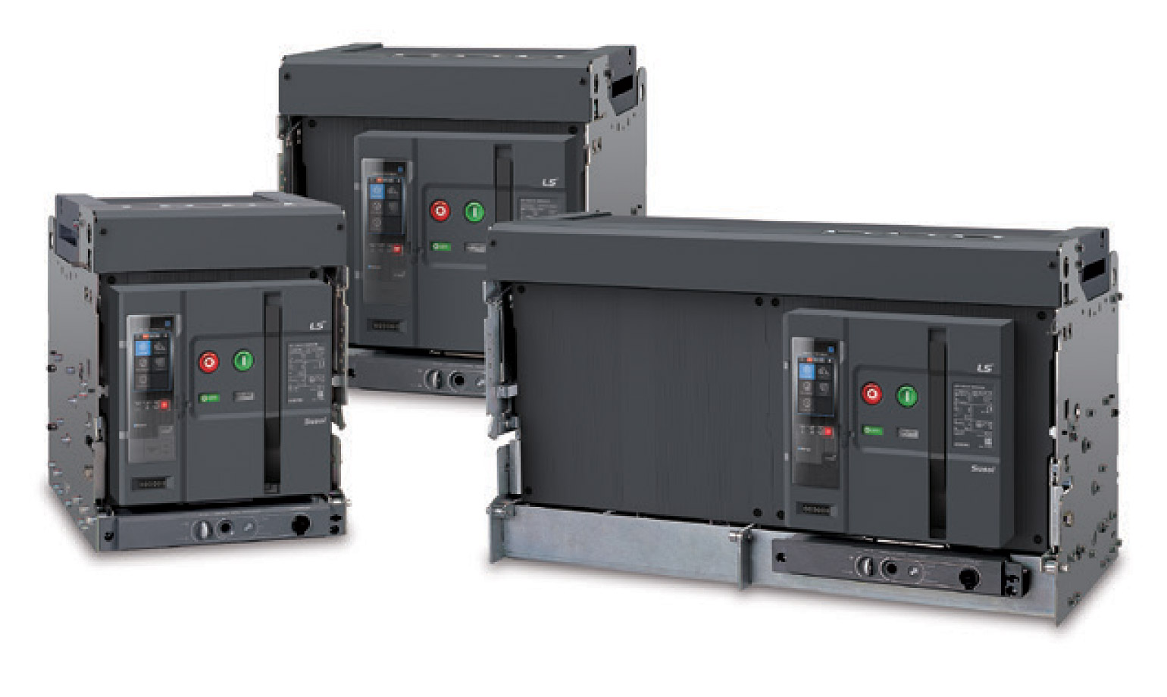

Specialty Manufacturing
MCCB & ACB PRODUCT INVENTORY
LS Electric Breakers
We source next-generation breaker technology and industrial-grade switchgear directly through our strategic partnership with LS Electric—a sister company to LG Electronics and a global leader in low- and medium-voltage distribution. Designed for commercial-scale reliability, LS products are manufactured in automated, AI-driven facilities to ensure quality and consistency at scale. Our direct-to-manufacturer model accelerates lead times and reinforces LS’s growing presence in the U.S. market.
Featured lineup with additional models available:
MCCBs
Susol
Susol UL
ACBs
Susol
Susol UL

Slide 8
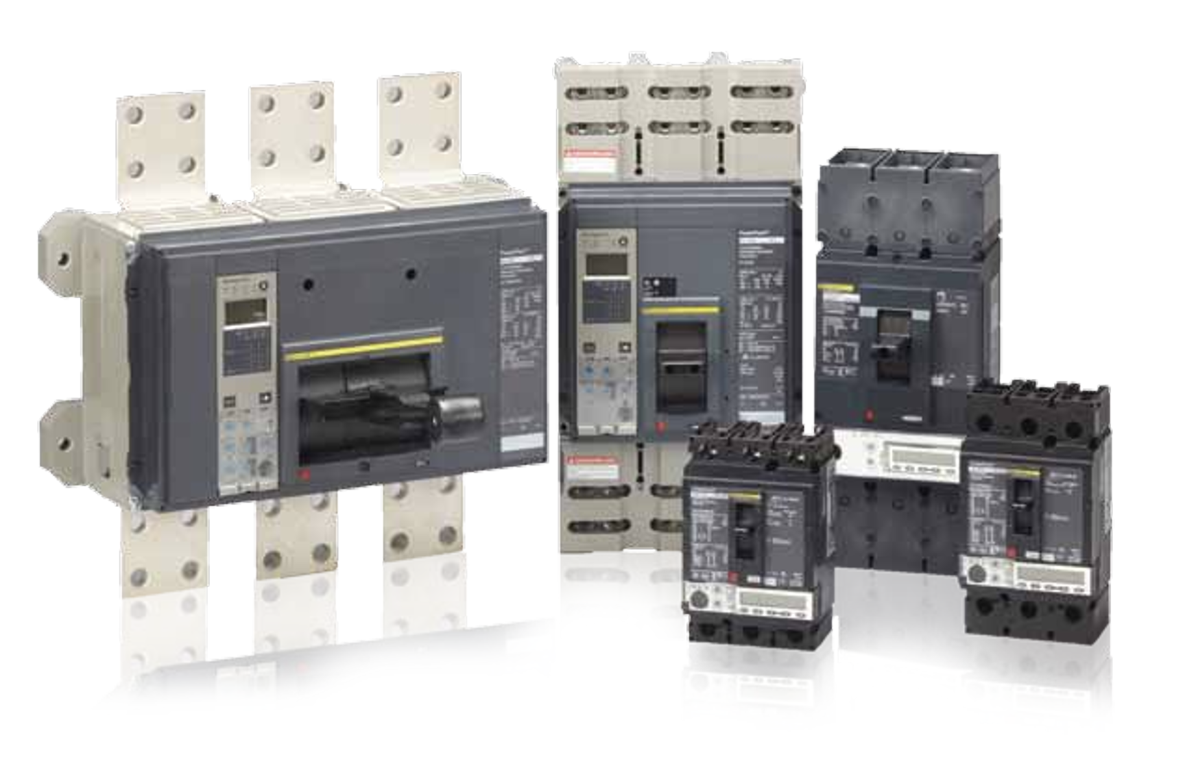
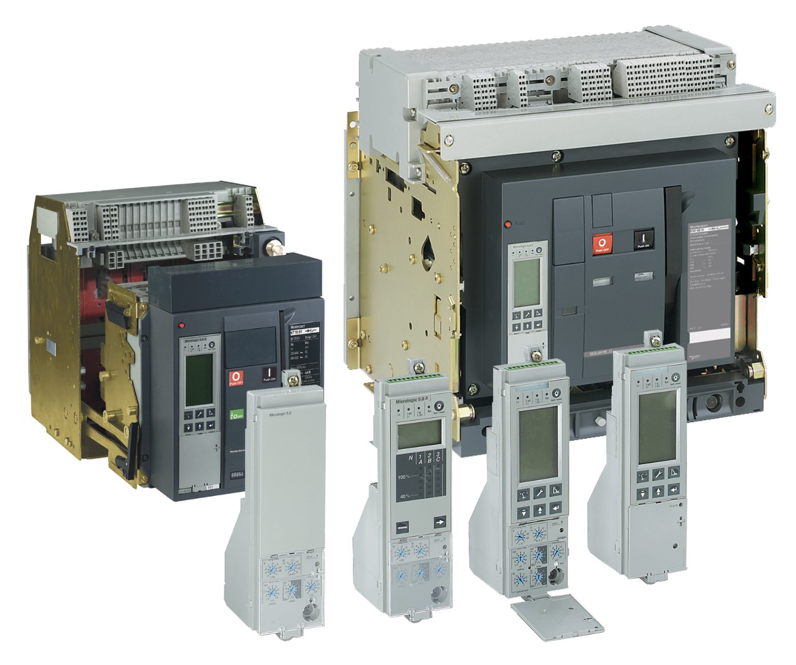
Specialty Manufacturing
MCCB & ACB PRODUCT INVENTORY
Schneider Electric (Square D) Breakers
As a certified provider of Square D components, Power Design builds with trusted, industry-recognized MCCBs and ACBs. Known for durability, ease of integration, and widespread utility compatibility, Square D gear helps us deliver consistent performance across complex commercial power systems.
Featured lineup with additional models available:
MCCBs
• LA, LH, Q4
• PowerPacT
  B-Frame
  H-Frame
  J-Frame
  Q-Frame
  L-Frame
  M-Frame
  P-Frame
  R-Frame
ACBs
• MasterPacT DC
• MasterPacT MTZ
• MasterPacT NT and NW – UL/ANSI
• Micrologic Trip Units

Slide 9
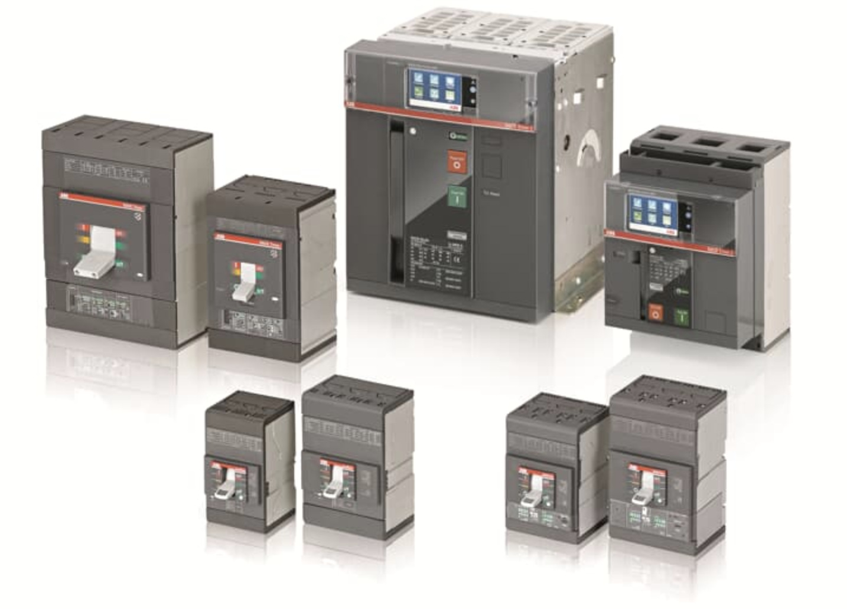
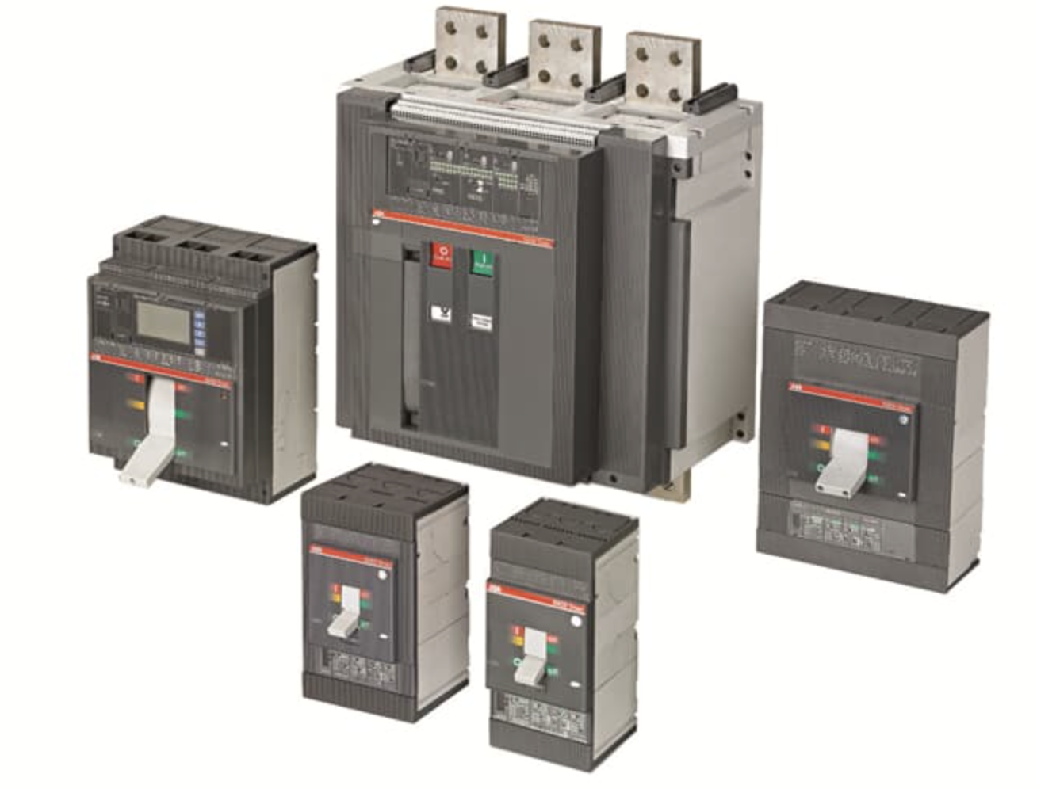
Specialty Manufacturing
MCCB & ACB PRODUCT INVENTORY
ABB Breakers
Power Design is the top load center builder for ABB in the U.S., and one of ABB’s leading national OEMs. With millions of dollars in ABB breaker and metering inventory dedicated to our switchboard builds, we offer a wide range of reliable MCCBs and ACBs designed to support demanding commercial power needs.
Featured lineup with additional models available:
MCCBs
SACE® Tmax® XT
SACE® Tmax® T
SACE® FORMULA
Record Plus
TEY Lighting Panel Circuit Breakers
Thermal Magnetic E150
ProLine Circuit Breaker
Q-Line Miniature Circuit Breakers
ACBs
• SACE® Emax 2

Slide 10
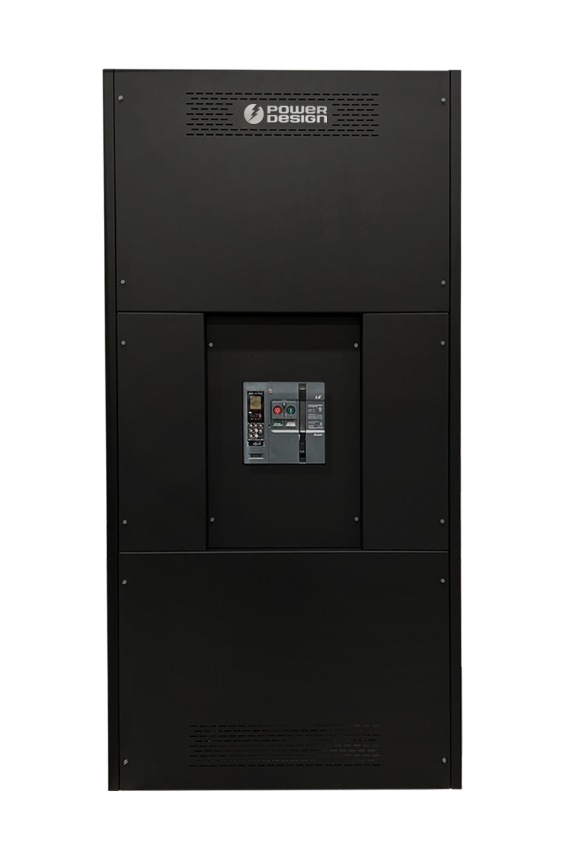
Specialty Manufacturing
PD-UL 891 SWITCHBOARD
Additional Structure Features
Molded Case Circuit Breaker
Assembled with a switch and trip structure into an insulated container, the breaker can switch on and off an electric circuit with currents either manually or through electrical operation. The device automatically disconnects electrical currents in cases of abnormal conditions such as overloads and short circuits.
Framing
The frames of PD-UL891 switchboards are designed as a solid structure. Individual switchboard sections are built from formed steel channels, then secured together with thread-rolling screws. The frames are firmly fixed to base channel. When base channel is applied, the warp of the frame can be minimized, and the internal parts can be supported stably.
Door and Cover
For stronger structure, all covers and doors are made of formed steel. Also, the removable plates with formed edges cover the back and all covers are fixed with slot/hex head thread rolling screws.
Enclosure
PD-UL891 switchboards are available in NEMA Type 1 indoor enclosures.
Cable Compartment
Cable compartments are designed with enough wire-bending space to facilitate cable termination and installation. For cable operations, a workspace considering the radius of curvature of the cable is required.
• Designs for cable, bus duct riser, cable bus, cable duct,
and transformer connections
• Secure front access with completely isolated control
and communication wiring sections
• Booth structure enabling future installation and expansion
of additional equipment

Slide 11
Specialty Manufacturing
PD-UL 891 SWITCHBOARD
Bus System
The bus is installed in the rear section of the switchboard. All 1000A sq in bolted copper bus is provided as UL891standard. The busbar is silver-plated electrolytic copper.
Main and Vertical Bus
The Main Bus ratings are 2000, 2500, 3200, 4000, 5000, and 6000A with short circuit current rated up to 100kA in all types. The Vertical bus ratings are also 2000, 2500, 3200, 4000, 5000, and 6000A with short circuit current rated up to 100kA.
Neutral and Branch Bus
Neutral bus is rated 100% of main bus rating. The sectional area for all types of ground busbar is ¼” X 4”. The Branch bus ratings depend on circuit breaker ratings.
Short Circuit Current
Rated short circuit current is up to 85kA at D-frame ACB (800-1600A),
85/100kA at E-frame ACB (800-3200A) and 100kA at G-frame ACB
(3200-6000A). UL MCCB of LS Electric is applied to the interior and
the maximum short circuit current rating of the interior is 100kA at
480Vac (depends on MCCB type).

Slide 12
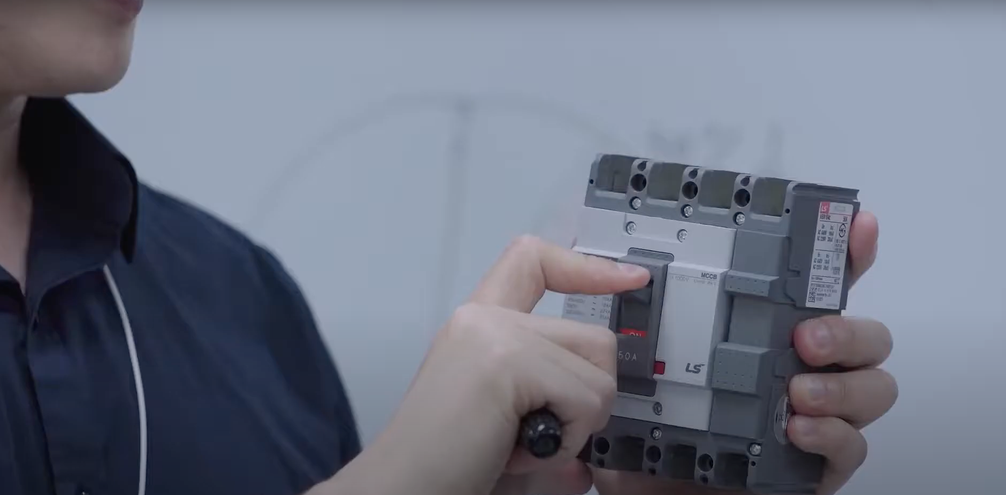
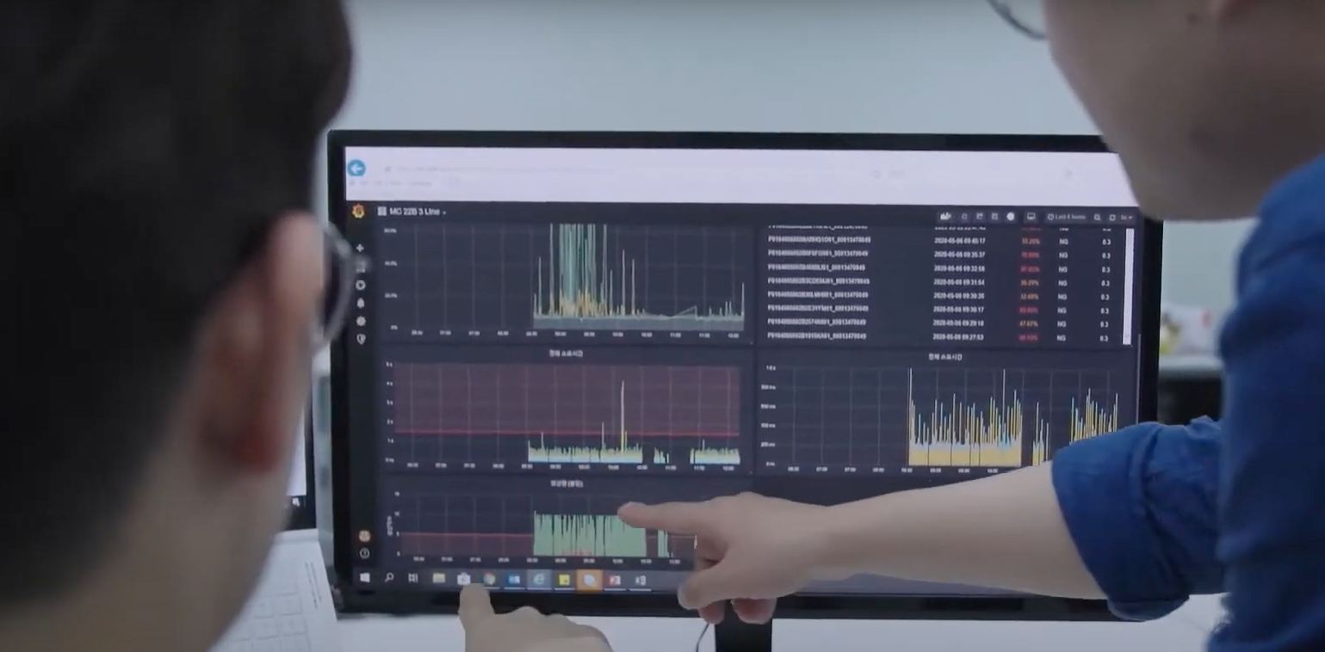
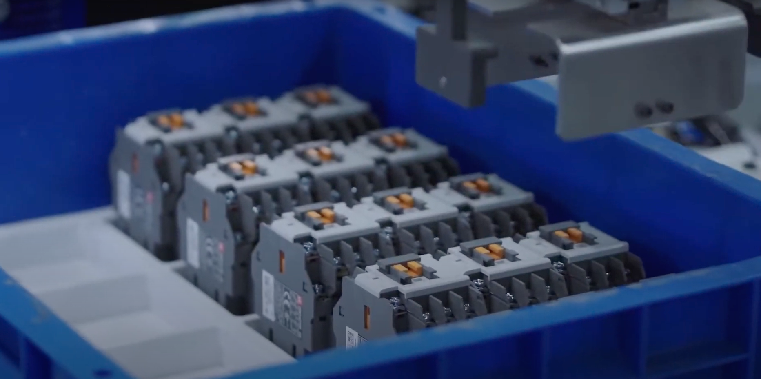
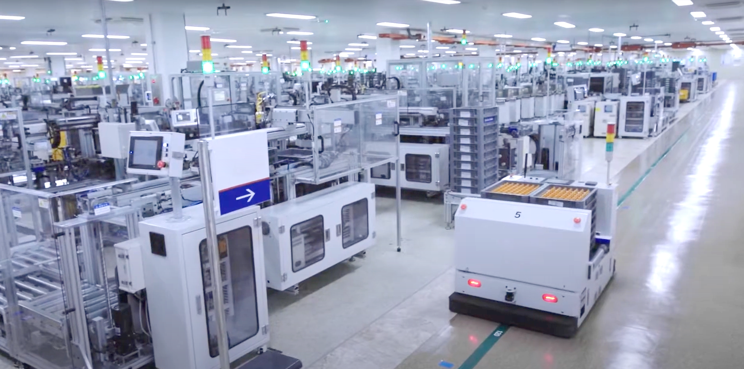
Specialty Manufacturing
PD-UL891 SWITCHBOARD & COMPONENTS
Quality and Testing
As an organization recognized and trusted for its quality and safety record,
Power Design’s Switchboards go beyond the standards for assurance and reliability:
UL Certified product, testing and accredited in UL laboratories
UL Certified Power Design staff member present in production facility, monitoring the assembly process
Each breaker is quality inspected upon completion
(vs industry standard of periodic testing)
Components processed through short circuit testing of 2,000MVA capacity, high voltage testing, and reliability testing
Components’ testing process includes human monitoring, diagnostic testing, as well as application of machine learning models—in partnership with Microsoft Azure—to evaluate load data and responses to ensure optimal quality.

Slide 13

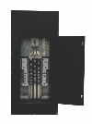
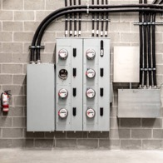
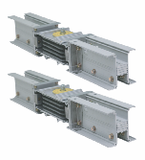
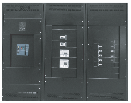
Specialty Manufacturing
POWER DESIGN MANUFACTURED & PARTNER PROCURED
Additional Products with Expedited Delivery
Removing Risk and Delays from the Critical Power Chain
Panelboards
Load Center
Meter Mains
Busways, Busway Sleeves,
Enclosures, Troughs, Junction Boxes
Switchboards,
VFDs, Transformers,
Ground Bar Assemblies

Slide 14

Specialty Manufacturing

